Slide 1



TEJA SUBBANNA INTURI MANASA
(TEAM MEMBERS)

Slide 2


AI in Agriculture

Slide 3
Optimizing Agricultural Production
INSPIRATION : To feed today's global population, we currently need farmland equivalent to the size of South America. Despite the exorbitant amount of land already allocated to agriculture, an estimated 815 million people worldwide still go to bed hungry each night. Moreover, the worldwide population is estimated to be 9 billion by the end of 2050. Modern-day cities in the world already contain half of the world's population, which follows that the impact of the projected surge in global population will drastically decrease the amount of habitable land to extreme levels in order to maintain modern infrastructure. In this rapidly changing world already brimming with hunger and agricultural difficulties caused by lack of land, we believe that our solution with underpinnings in sustainable agriculture and artificial intelligence provides a feasible solution.

Slide 4

GETTING STARTED
Before running the project, there are a few requirements that need to be met:
Python 3.7 or higher: The project is written in Python, so you'll need to have it installed on your system. You can download Python from the official website: https://www.python.org/downloads/
Jupyter Notebook: The project is written in Jupyter Notebook, an open-source web application that allows you to create and share documents that contain live code, equations, visualizations, and narrative text. You can download Jupyter Notebook from the official website: https://jupyter.org/install
Python packages: The project relies on a number of Python packages that need to be installed before running the code.
DATA*
The dataset involves the following features: N - ratio of Nitrogen content in soil, P - ratio of Phosphorous content in soil, K - ration of Potassium content in soil, Temperature, Humidity, pH, Rainfall, Label
*Pre-existing data and datasets on the internet.

Slide 5
MODEL BUILDING
We will build a Logistic Regression model for crop optimization. The following steps will be followed:
Exploratory Data Analysis (EDA), Data Preprocessing (handling missing values, encoding categorical variables, feature scaling, etc.) Feature Selection (identifying important features for the model) Model Selection (comparing different algorithms and selecting the best one) Model Evaluation (measuring the performance of the selected model)
TOOLS & LIBRARIES
This project will be implemented in Python. The following libraries will be used:
Pandas for data manipulation, NumPy for numerical operations, scikit-learn for model building and evaluation, matplotlib and seaborn for data visualization.
CONCLUSION
Optimizing crop production can help farmers identify potential ways to grow good quality of crops.

Slide 6
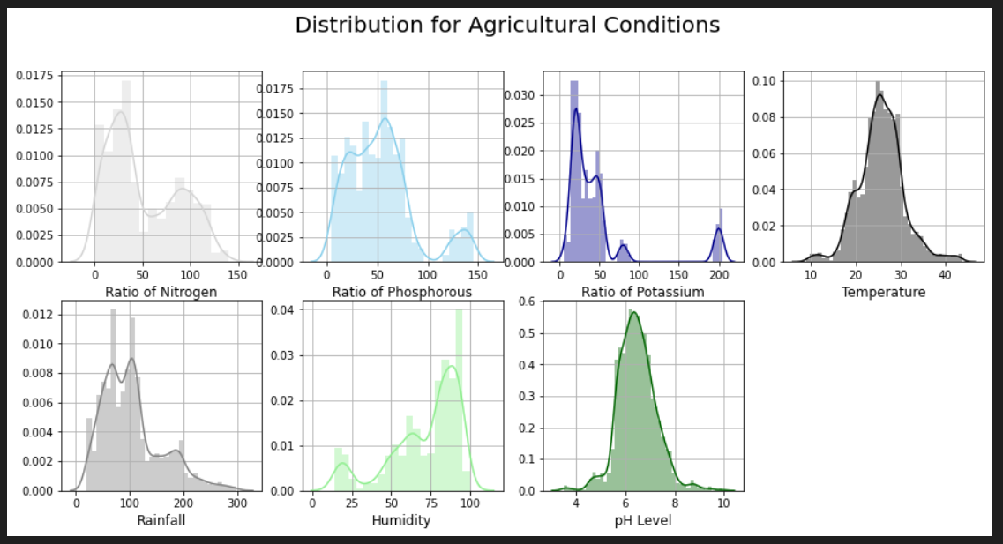
OUTPUTS & FEEDBACKS

Slide 7
Collaborative Potential:
Exploring opportunities for collaboration with agricultural communities, research institutions, or industry partners could enhance the project's reach and ensure that it aligns closely with the needs of the end-users.
Ethical and Social Implications:
The project acknowledges the ethical implications of AI in agriculture, which is commendable. Continued reflection on the social and ethical aspects, along with strategies for responsible deployment, would add depth to the project's impact.
Scalability:
Consideration for the scalability of the AI solutions presented is crucial for widespread adoption. Further exploration of how the project can be scaled for different farm sizes and regions would be beneficial.

